Slide 1
C.T. Walker Magnet Elementary Title I Annual Meeting
Day: Thursday
Date: 8-29-2024
Time: 5:00pm
Location: Cafeteria

Slide 2
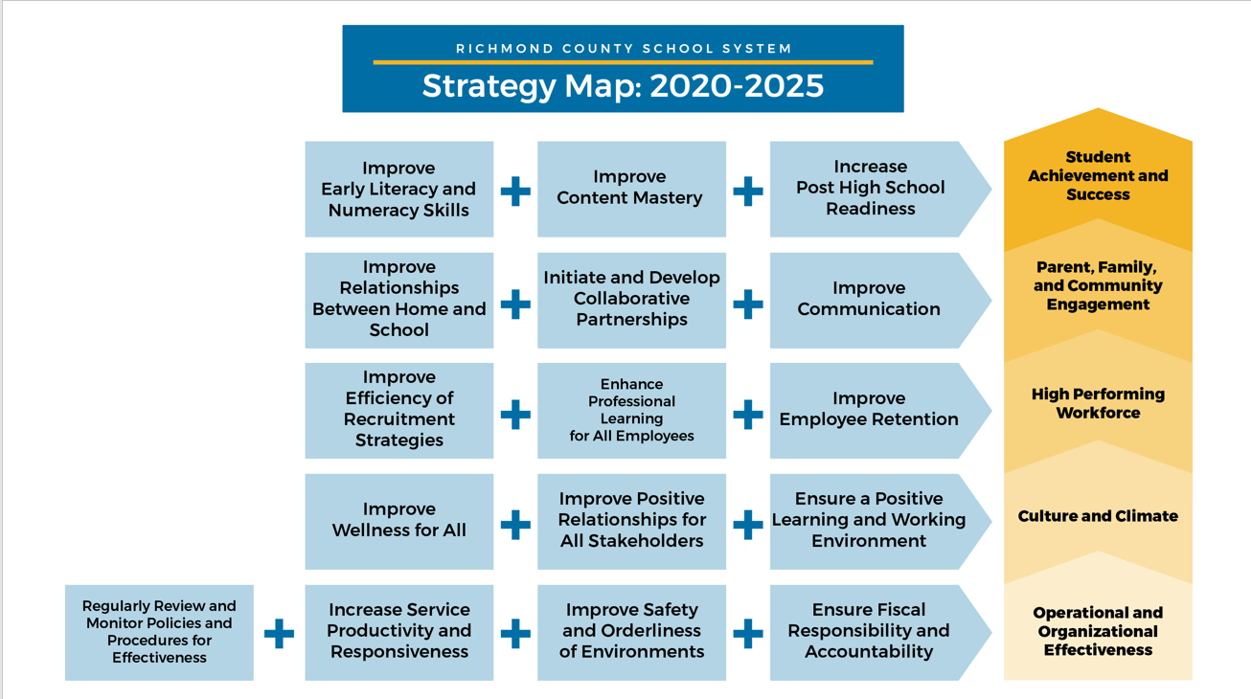

Slide 3
Notes:
We always refer to our vision and mission

Slide 4
What is a Title I School?
Title I, Part A of the Every Student ​Succeeds Act of 2015 (ESSA) ​provides financial assistance to states and school districts. It’s overall purpose it to ensure that all children have a fair, equal, and significant opportunity to obtain a high-quality education and reach, at a minimum, proficiency on challenging state academic achievement standards and assessments.​
Notes:
We encourage you to ask questions throughout the meeting. We value your input! We want to make sure you leave the meeting informed about the Title I program, as well as the opportunity to provide feedback.” Have parents to complete these surveys prior to leaving the meeting.
Mcallister

Slide 5
Title I Funding
1% of the total District’s Title I funding is for Parent Involvement​
Title I, Part A ​
Input from parents
Notes:
We encourage you to ask questions throughout the meeting. We value your input! We want to make sure you leave the meeting informed about the Title I program, as well as the opportunity to provide feedback.” Have parents to complete these surveys prior to leaving the meeting.
Mcallister

Slide 6
How does C.T. Walker Magnet participate?
Title I Schoolwide Program

Slide 7
How does the school spend funds?
Title I Part A
Title I funds are authorized and can be used to provide additional staff, professional development; instructional materials; improve curriculum; enhance parental involvement; extend learning time for students who need extra help; and provide other activities that are tied to raising student achievement on the State’s academic achievement standards.
Notes:
We encourage you to ask questions throughout the meeting. We value your input! We want to make sure you leave the meeting informed about the Title I program, as well as the opportunity to provide feedback.” Have parents to complete these surveys prior to leaving the meeting.
Mcallister

Slide 8
Requirements For a Title I Schoolwide Program
A Title I school is eligible to become a Title I Schoolwide Program when the poverty level, (determined by free and reduced meal counts, Aid for Dependent Children [AFDC], census, or Medicaid) is at or above 40%.
Serves all students in the school, but requires special focus for lowest achieving
Combines federal funds into total school budget
Is supplementary. The amount of Federal funds used in a schoolwide program must be supplemental to the amount of State and local funds the school would otherwise receive

Slide 9
Title I School-wide Program
School-wide goals
Programs/Supports in place to help our children
State’s Grade Report

Slide 10
Richmond County School District Goals
During the 2024-2025 school year, we will increase student content mastery in ​tested subject areas on the Georgia Milestones by 5%. ​​​ During the 2024-2025 school year, we will increase the number of highly effective teachers and leaders retained in RCSS by 3%.
During the 2024-2025 school year, we will increase post-high school readiness by ​increasing our graduation rate from 81% to 83%.
Notes:
We encourage you to ask questions throughout the meeting. We value your input! We want to make sure you leave the meeting informed about the Title I program, as well as the opportunity to provide feedback.” Have parents to complete these surveys prior to leaving the meeting.
Mcallister

Slide 11
School Improvement Goals
During the 2024-2025 school year, we will increase the percentage of students in grades 3-5 scoring at the Proficient or Distinguished level on the ELA portion of the GMAS will increase from 67% to 72%.
During the 2024-2025 school year, we will increase the percentage of students in grades 3-5 scoring at the Proficient or Distinguished level on the Math portion of the GMAS will increase from 68% to 72%.
During the 2024-2025 school year, we will increase parental engagement and involvement as well as promote student and staff morale by hosting at least 5 schoolwide events that include celebrations, collaboration, and team building for all stakeholders as evident by stakeholder surveys, student health surveys, and Panorama data.
Notes:
We encourage you to ask questions throughout the meeting. We value your input! We want to make sure you leave the meeting informed about the Title I program, as well as the opportunity to provide feedback.” Have parents to complete these surveys prior to leaving the meeting.
Mcallister

Slide 12
C.T. Walker Magnet
Parent and Family Engagement
Title I programs bring parents, the community, and the school together to improve academic achievement of students.
We encourage your engagement in:
School Improvement Plan (SIP)
School Council
Committees
Notes:
We encourage you to ask questions throughout the meeting. We value your input! We want to make sure you leave the meeting informed about the Title I program, as well as the opportunity to provide feedback.”
Jackson

Slide 13
Parent and Family Engagement
District Parent and Family Engagement Policy
Initiated by Title I and sent out by the school
Dissemination of state policies
School Parent and Family Engagement Policy
Gives information about stakeholders as they relate to Title I
Soliciting parent and community involvement in school
School/Parent Compact
An agreement between all stakeholders to ensure that students are meeting their educational goals.
Notes:
– Suggested language, “
This plan describes how the school will carry out its obligation to conduct outreach and provide activities, programs, and procedures to all parents of Title I students.
Johnson

Slide 14
School Parent and Family Engagement Policy
Each school that receives Title I funds must jointly develop, agree on with, and distribute to parents of children receiving services a written parental involvement policy. The school parental involvement policy describes how the school will carry out the parental involvement requirements to ensure effective involvement of parents and to support a partnership among the school, parents, and the community to improve student academic achievement.

Slide 15
School - Parent Compacts
Each school that receives Title I funds must jointly develop and revise with parents a school-parent compact as part of the school-level parental involvement policy. The school-parent compact is an agreement that outlines how parents, the entire school staff, and students will share the responsibility for improved student academic achievement and the means by which the school and parents will build and develop a partnership to help children achieve the state’s high standards.

Slide 16
Collaborative Effort
Planning is a mechanism for building a constituency to support school change and should involve school staff, parents, and the community.

Slide 17
Parent Right to Know
Rights to request teacher qualification
Notify if child has been taught by a non-highly qualified teacher for more than four weeks
Letters are sent home to parents at beginning of school year or if necessary throughout the year.

Slide 18
Parent Decision Making Opportunities
Parents have a right to:
Request opportunities for regular meetings
Formulate and share suggestions
Be active participants in the educational decision making process (via Title One school-wide committee, school council meetings, PTA, etc.)
Notes:
Simon

Slide 19
C.T. Walker Magnet Elementary School 1301 Wrightsboro Rd. (706)-823-6950 Nakia Johnson, Assistant Principal johnsna@boe.richmond.k12.ga.us Federal Programs Department 864 Broad Street​ (706) 826-1134​ Angeline Andrews-Milton, Federal Programs Director​ ​
Title I Contact Information

Slide 20
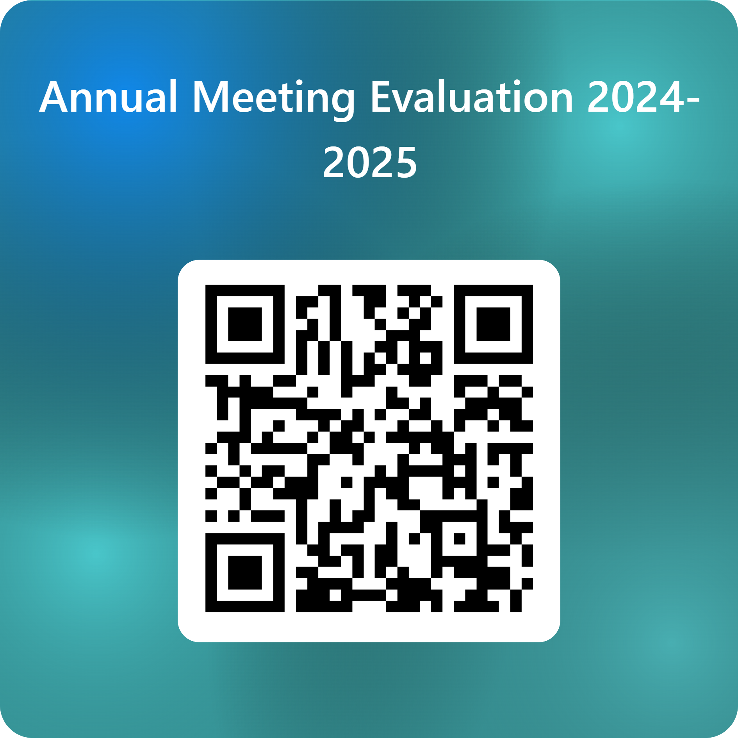
Please complete your evaluation before leaving…
Evaluations
Thank You!!!!!

